Slide 1
Mechanisms of positive force frequency relationship in myocytes

Slide 2
K52 increased to 0.00667 from 0.001325 ms-1
Nai clamped at 10 mM

Slide 4
K52 increased to 0.00667 from 0.001325 ms-1
Differential Nai

Slide 6
Determinants of positive vs negative force frequency relationship (clamping) – RyR
Positive
Negative

Slide 7
Are leaky channels responsible for positive force frequency relationship ?

Slide 8
Determinants of positive vs negative force frequency relationship (clamping) – ICaL , SERCA, NCX
Positive
Negative

Slide 9
Determinants of positive vs negative force frequency relationship (with k52 increased) – RyR
Negative
Positive

Slide 10
Positive
Negative

Slide 11
Can we selectively augment SR pump function at higher frequencies to compensate for lower RyR open fraction?
SERCA 1.5X Vmaxr 2X (Nai clamped at 10 mM)
K52 = 0.00667

Slide 12
How do we see a positive Ca – Frequency relationship at low diastolic Calcium?
RyR Dynamics
Leak has been eliminated by not approaching physiologically unrealistic diastolic Ca concentrations.
Peak RyR open :
1Hz > 2Hz ~ 0.5 Hz
At higher frequencies, higher diastolic Ca leads to lower availability, at low frequencies, despite 100% availability, low peak Ca leads to lower peak open probability.
RyR Flux:
1Hz ~ 2Hz > 0.5 Hz
Although the peak open probability is lower at 2 Hz, higher SR Calcium compensates leading to comparable flux

Slide 13
How do we see a positive Ca – Frequency relationship at low diastolic Calcium?
Intracellular Calcium fluxes

Slide 14
SERCA 1.5X Vmaxr 2X (Differential Nai clamped)
With differential clamping the NCX current is not able to sufficiently extrude at higher pacing frequencies. Unrealistically high diastolic Ca

Slide 15
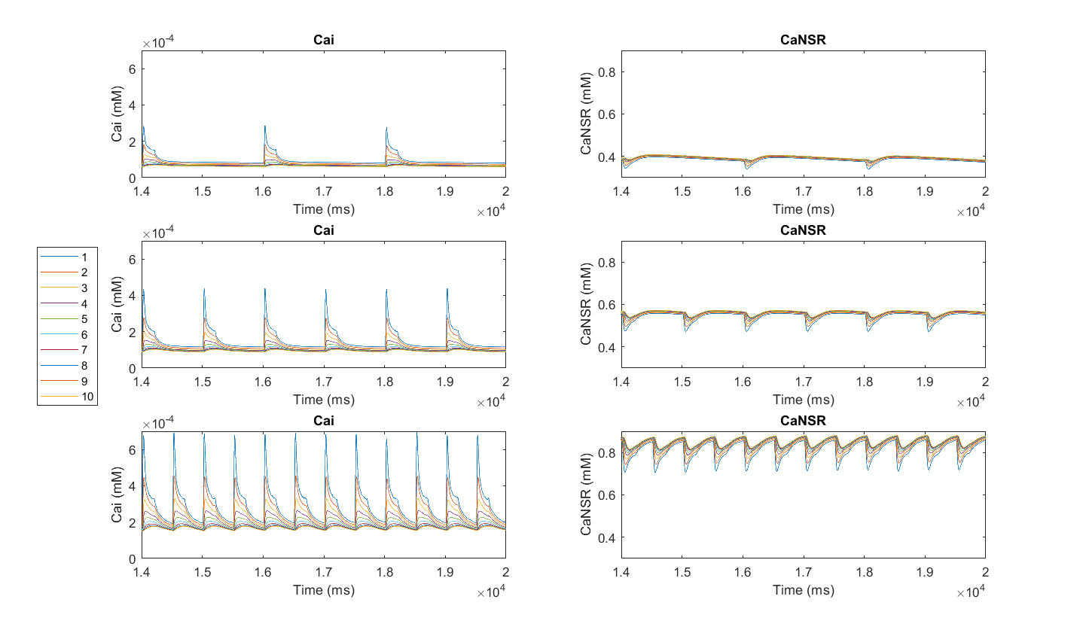
De-tubulated model with SERCA 1.5X Vmaxr 2X (Nai clamped at 10 mM) K52 = 0.00667 and SR Volume increased by 20%

Slide 16
Baseline detubulated model – 10% tubulated

Slide 17
RyR Flux and channel behavior

